Slide 1




iMapInvasives Training
Date
While you’re waiting for us to start…
Please introduce yourself in the chat box:
^{Your Name}
Your name & organization
  (if applicable)
Have you used the iMap Mobile App before?
Favorite place to hike?
@nyimapinvasives
@nyimapinvasives
Notes:
Say everyones full intro in the beginning
Transitions (pass off to “First name” and Org)
Assistant Horticultural Inspector 1
Annise – Post doctoral fellow, Yale School of the Environment
Have you used iMap Mobile App (avid vs. occasional vs. first time)

Slide 2
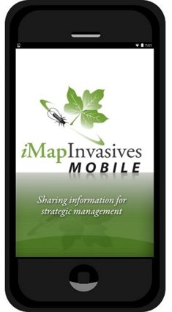
Today’s Agenda
1.
2.
3.
4.
5.
Notes:
Buckthorn, Bittersweet, Garlic mustard, Phragmites, Tr

Slide 3

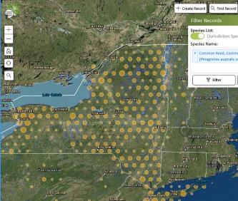
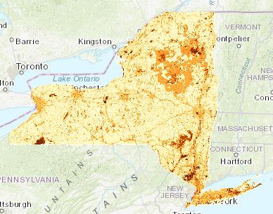

NY Natural Heritage Program
NY Natural Heritage Program
Invasive Species Database Program
Our mission is to facilitate conservation of New York's biodiversity by providing comprehensive information and scientific expertise on rare species and natural ecosystems to resource managers and other conservation partners.
Partnership between NYS DEC and SUNY ESF
Trees for Tribs
https://www.nynhp.org/treesfortribsny
Conservation Guides
https://guides.nynhp.org/
Spatial Prioritization Models

Slide 4
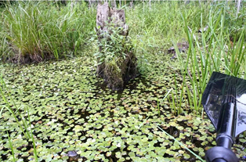
Invasive Species
Invasive species are species of plants, animals, insects, and pathogens that are:
  1. Non-native
  2. Negatively impactful
    Harm to environment, economy, and human health
    European frogbit

Slide 5
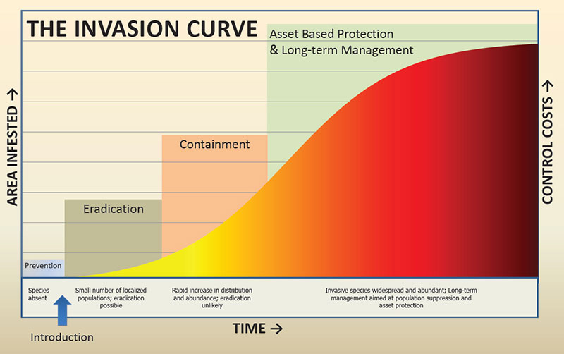
Invasive species – What do we do?
Notes:
PRISMS

Slide 6
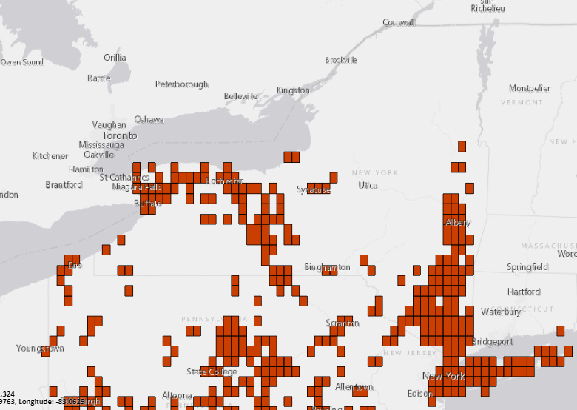
Tree-of-heaven Distribution
Not detected records
Data gap?
Legend
Confirmed presence
Notes:
Replace with iMap
Label not detected

Slide 7
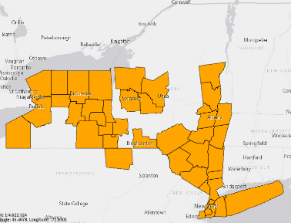


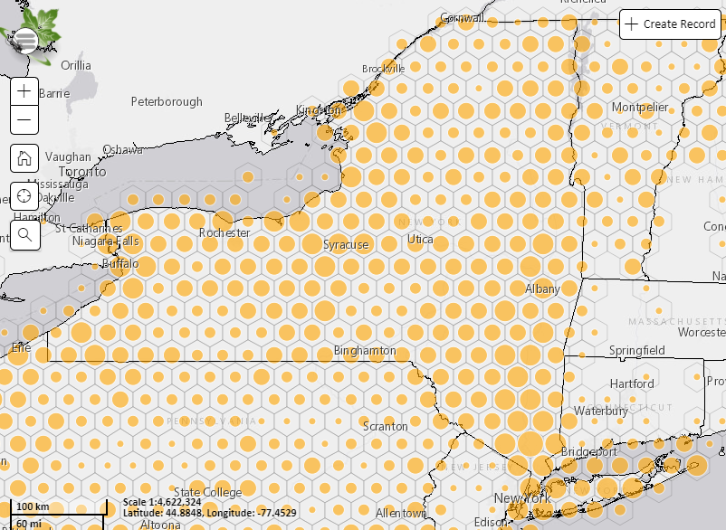
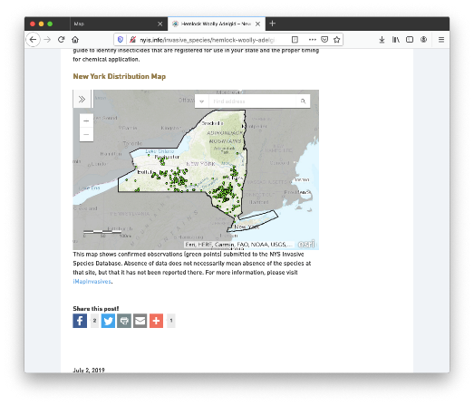
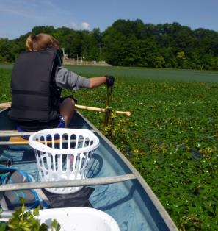
iMapInvasives
Centralized invasive species database to support PRISMs, state agencies and other partners working on invasive species issues.
4
Species Distributions and Reports
Early Detection Alerts
Tracking Control Efforts and Results
Web Map Services

Slide 8
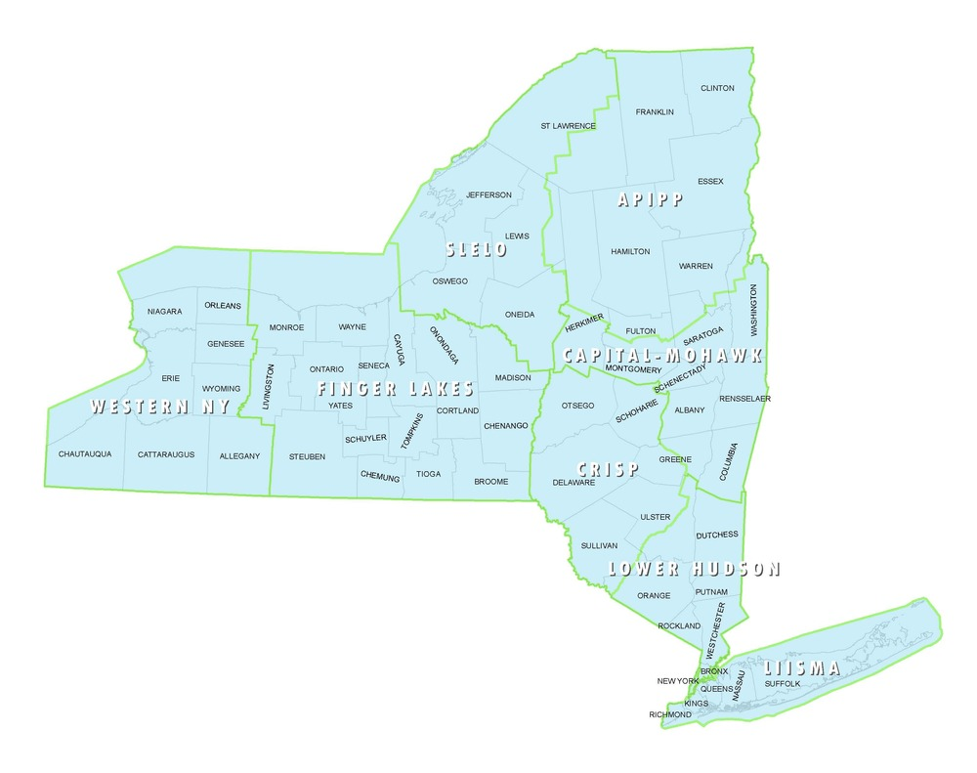
PRISM
Partnership for Regional Invasive Species Management
Management
Prevention programs
Surveillance and mapping
Habitat restoration
Early Detection Rapid Response
Coordinate volunteer/ CitSci efforts
More!
APIPP
Adirondack Park Invasive Plant Program
SLELO
Saint Lawrence and Eastern Lake Ontario
Capital Region
Finger Lakes
Western NY
Catskill Regional Invasive Species Partnership
CRISP
Lower Hudson
LIISMA
Long Island Invasive Species Management Area
MO
Notes:
PRISMS ON TOP
Listserve

Slide 9



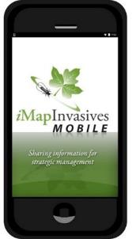
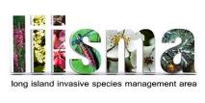
Data sources
Uploads of existing data from partner organizations
  Local, State, and Federal Agencies
  Land/ Water Managers
  Researchers
  Museum Data
Data entered by community scientists & professionals
Species ID confirmed by experts
And you!
NYISRI

Slide 10





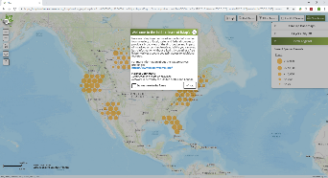



Mobile App vs. Online
Mobile App
Online Web Application
Collecting Simple Data: Mobile app
Download to your mobile phone or tablet,
Presence & Not-Detected
no connectivity needed to collect data
The Whole Database: On the web
Browser-based interface for your desktop or mobile phone, with connectivity
Presence & Not-Detected & Treatment
Queries/Reports/email alerts
Google Chrome or Mozilla Firefox

Slide 11
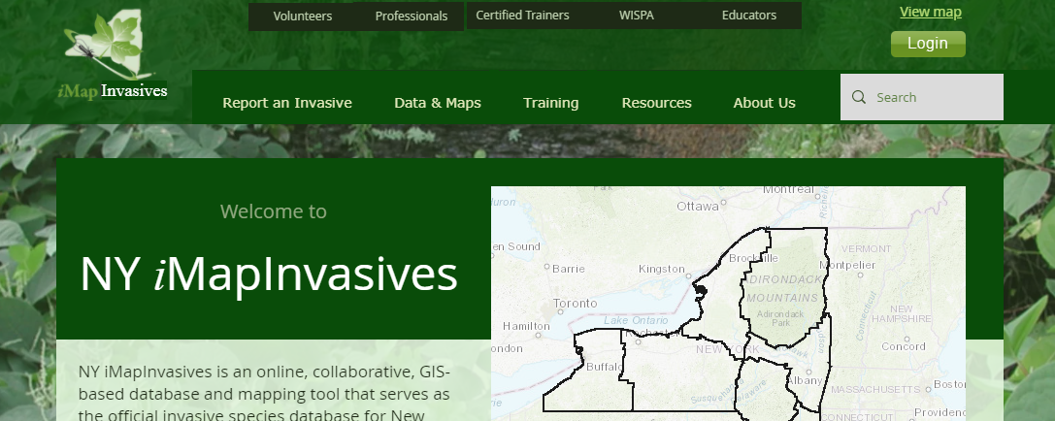
Account setup
nyimapinvasives.org
Please follow along

Slide 12
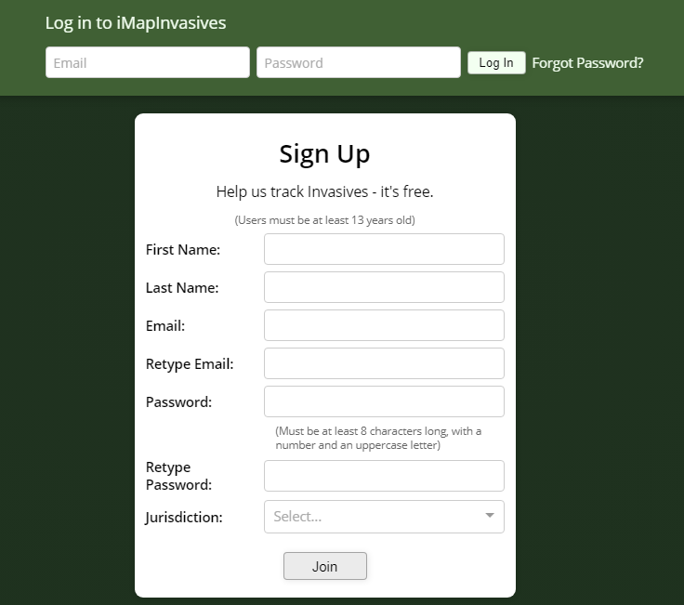


Create Account/Login
imapinvasives.natureserve.org
Login (if you have account)
*If you haven’t signed in since last Spring, click here to reset account
Create Account
Check email for link (“click here”), click open the User Agreement.
Read User Agreement and accept
New York
Notes:
Briefly read user agreement

Slide 13
Account setup
imapinvasives.natureserve.org
Once you create your account, make sure you use Login not Sign Up
Notes:
Redo to describe previous account vs new acct

Slide 14
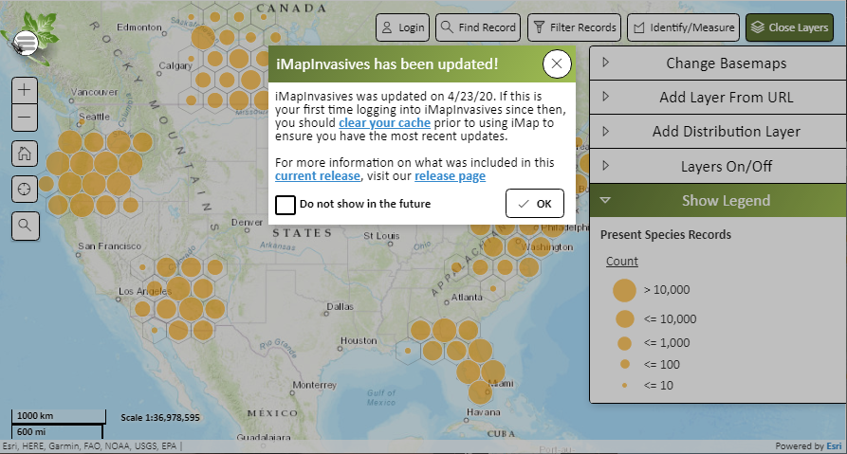
Log in
Notes:
Recently updated

Slide 15
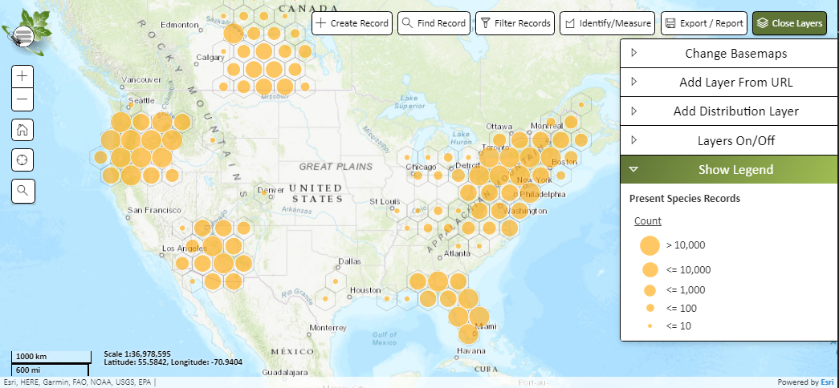
iMapInvasives Online
Main Menu
Main Menu
Action Tools
Navigation
Geographic Layers

Slide 16
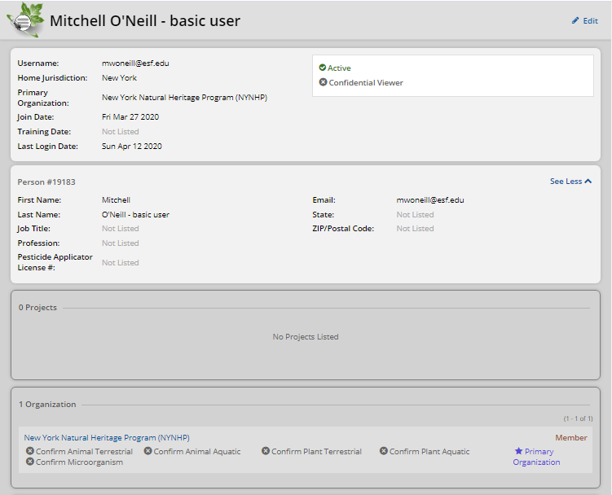
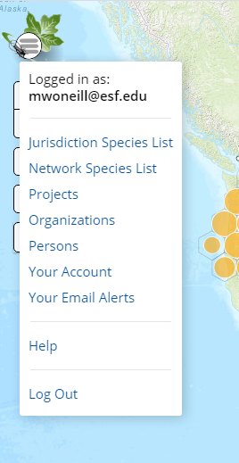
Your Account
Your info
Orgs and Projects

Slide 17
Organizations and Projects
Organizations
If you are doing invasive species surveys/management as a part of your job duties, join that organization.
Citizen scientists and volunteers do not need organizations
Projects
Great way to group data for a project/grant
Great for people volunteering for organization
Ex) Mapping efforts across organizations, PRISM-coordinated volunteer efforts
Notes:
Cover briefly
Recommended if you are staff
Not necessary (unfailiated volunteers,etc)
Individual vs. organizational project

Slide 18
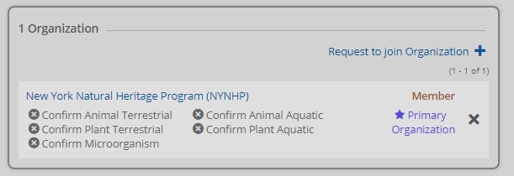
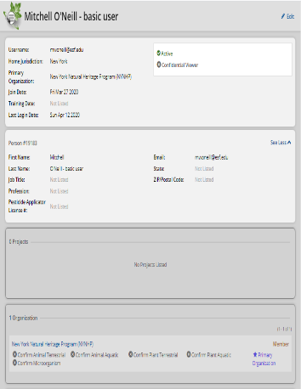
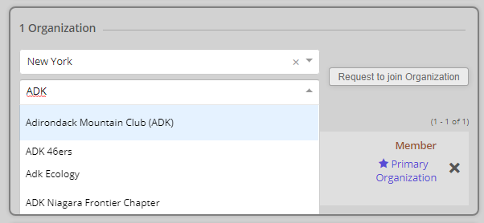
Joining Your Organization
Click “Edit” on the top right.
Scroll down to the organizations box and click “Request to Join …”
Type your organization into the search bar and click your organization in the drop-down.
Click “Request to join …”
Press on the top right corner
Now, this organization will appear on your account. You will be listed as pending until the admin for your organization changes you to Member
Notes:
Go through quickly, but we do have help docs

Slide 19
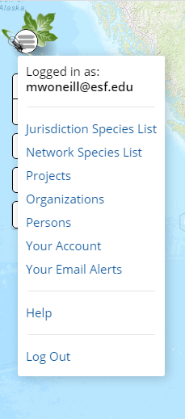
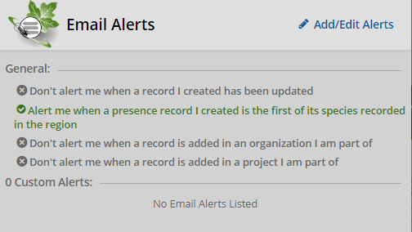
Account Setup - Email Alerts
Important Feature set up so that state officials are alerted to new observations
Everyone can use these alerts to stay informed on species/geographic areas they are interested
European Frogbit in Capital Region PRISM
General alerts you can opt in or out of
Custom Alerts

Slide 20
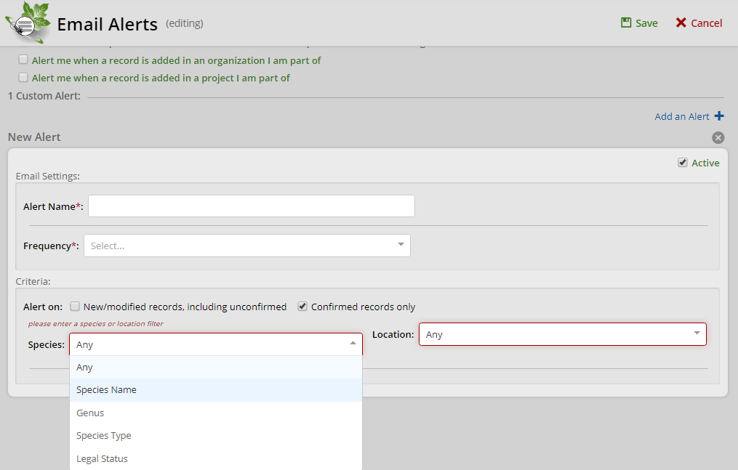
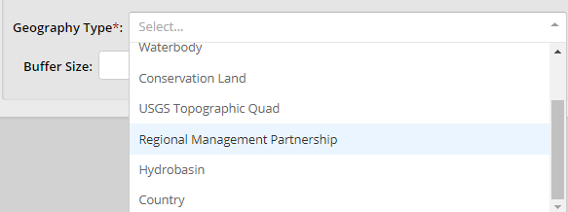

Custom Email Alerts
This will be the subject on alerts
How often - digests
Enter Species Name
Plant/Animal/Microorganism
Aquatic/Terrestrial/Marine
Notes:
- HWA alert in Saratoga County?

Slide 21
Mobile App vs. Online
Mobile App
Online Web Application
Questions on Account set up online?
Type into the chatbox!
Collecting Simple Data: Mobile app
Download to your mobile phone or tablet,
Presence & Not-Detected
no connectivity needed to collect data
The Whole Database: On the web
Browser-based interface for your desktop or mobile phone, with connectivity
Presence & Not-Detected & Treatment
Queries/Reports/email alerts
Google Chrome or Mozilla Firefox

Slide 22


Mobile App
Download app from Google Play or iOS App Store (search for “imapinvasives”)
Please follow along
Questions? Chatbox
Notes:
Andrew’s first slide

Slide 23




Mobile App
Setup Account and App
Record invasive species
Upload records to iMap
Connectivity required
Connectivity NOT required
Connectivity required

Slide 24
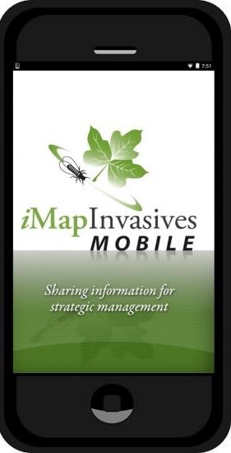
Live Demo
1. Set Preferences
“Retrieve iMap Lists”
Custom Species List
Set Default Project
2. Record an observation of “Fake Species”
3. Upload observations

Slide 25
Mobile App
Setup Account and App
Record invasive species
Upload records to iMap
Connectivity required
Connectivity NOT required
Connectivity required
Notes:
Workflow = connectivity sandwhich
Setup in connectivity
Record species observations in the field
Upload in connectivity

Slide 26
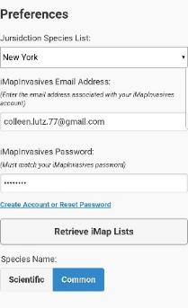
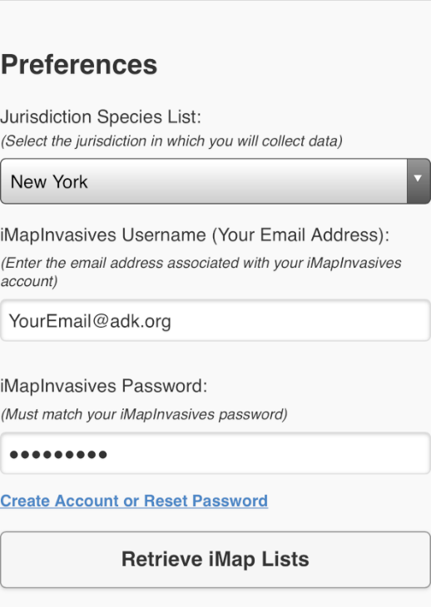
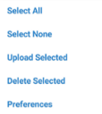
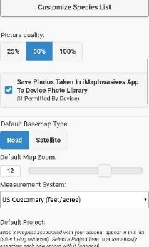
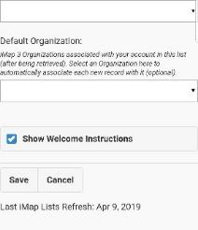
Mobile App Setup
Notes:
If it’s your first time logging in, it bring you straight to preferences (shown on left of slide)
If it’s not your first time, go to the menu icon on top lest and select preferences.

Slide 27
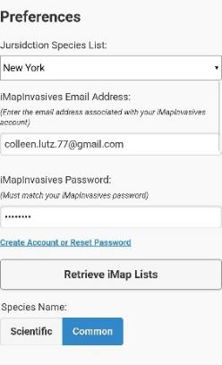
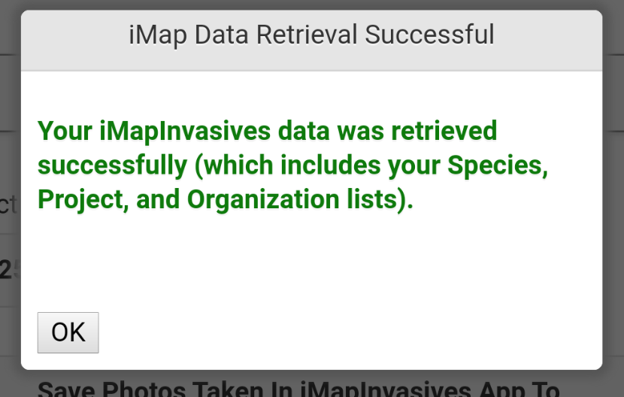



Mobile App Setup
Username and password Must match iMap account online
Sometimes iPhone’s add space after password
Notes:
Type in email and password (same as online account) and hit Retrieve iMap Lists
Green successful method = good
Error message – username password don’t match online, try again (careful with typos, make sure space isn’t added)
Tip – double check that you are able to sign in online (you may need to reset password)

Slide 28

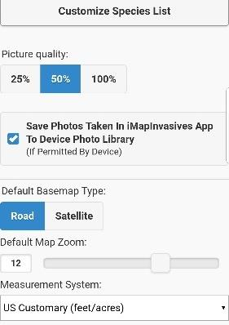

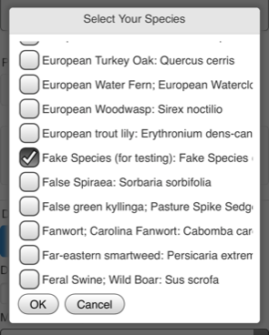
Preferences - optional
View lists as scientific or common names
Optional – Make a short list of species you know, are interested in, and expect to survey for in your area
European Fogbit
Fake Species
Jumping Worm
Tree-of-heaven
Water chestnut
Defaults are typically fine
Notes:
I listed species we are covering today in alphabetical order so you can scroll through and add them – make sure to add Fake species! We will use it for testing

Slide 29


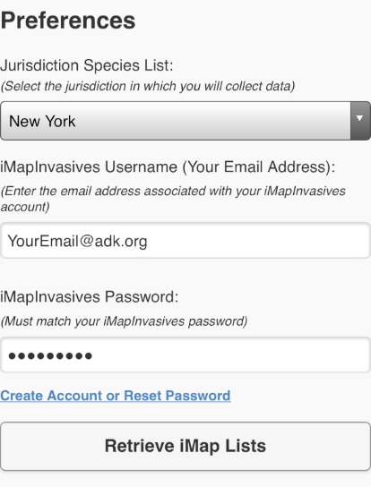
Mobile App - preferences
If your org/project is not appearing
1. Join Organization or Project Online
2. Select Retrieve iMap Lists
3. Set to Default
My Default Project
My Default Organization
Save!
Notes:
Set your default org and project if you have any.
Note: If your organizations and projects are not showing up as options here, it’s because you weren’t part of the organization or project when you first set up the app. Click “Retrieve iMap Lists” to refresh, and any organizations you are currently a member of will show up.

Slide 30



Mobile App
Setup Account and App
Record invasive species
Upload records to iMap
Connectivity required
Connectivity NOT required
Connectivity required

Slide 31
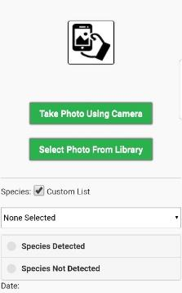
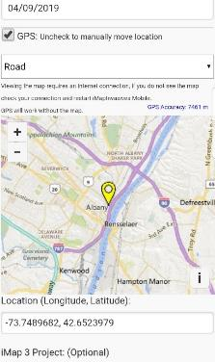
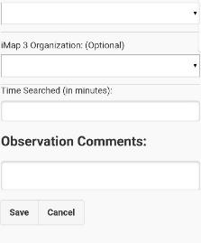
Add Observation
+Add Observation
Please follow along

Slide 32
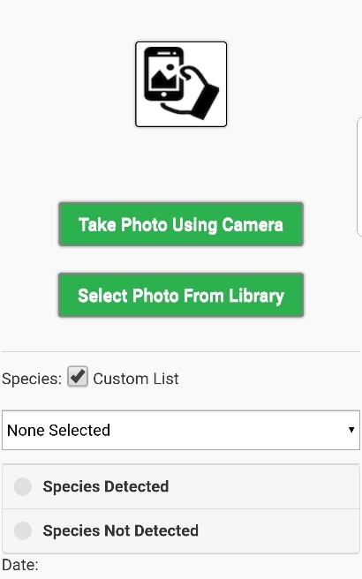

Add Observation
Take photo with camera
Enable your custom species list
Select Species – Fake Species
Select Detected or Not Detected
Notes:
We are having everyone follow along and enter a fake species record

Slide 33
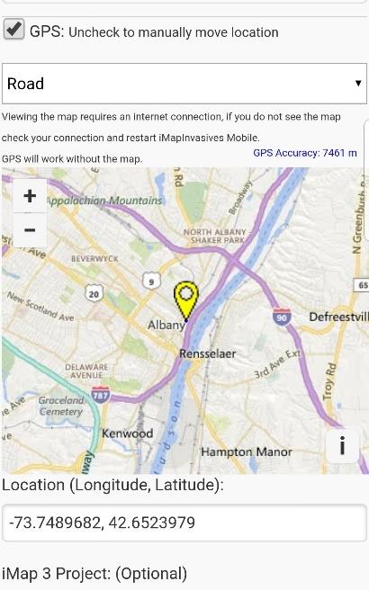
Add Observation
Note: Map will be blank when out of connectivity
Your location
Your coordinates: If 0,0 is displaying in the Location box, make sure your GPS is enabled on your device
Notes:
Note: map may be background when in remote areas (like in Adirondacks)
You are still fine as long as Lat/lon is showing up as a number

Slide 34

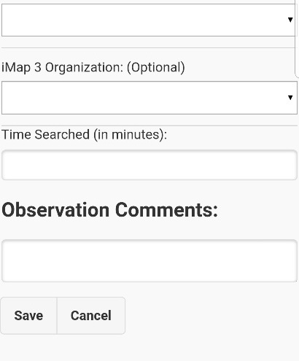
Add Observation
My Default Project
Change or select
My Default Organization
Enter the approximate time you were searching for invasive species (optional)
Add any comments that may enhance the quality of your observation report
Don’t forget to save your changes!
Notes:
Note that you can change or select org + project here, but we recommend setting defaults in preferences so they show up here without you having to worry about it.

Slide 35

Mobile App
Setup Account and App
Record invasive species
Upload records to iMap
Connectivity required
Connectivity NOT required
Connectivity required
AR

Slide 36
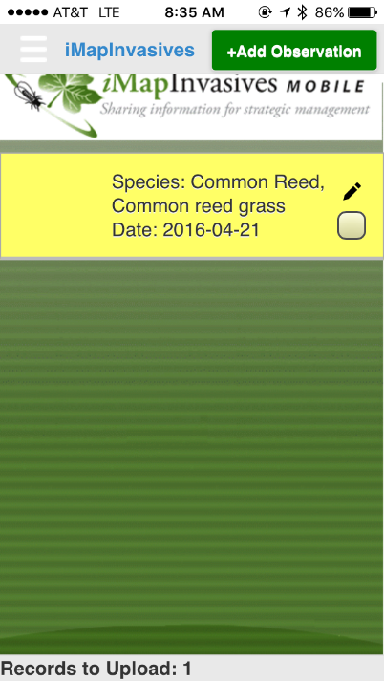
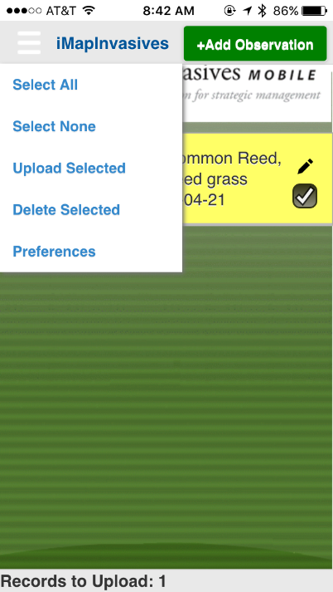
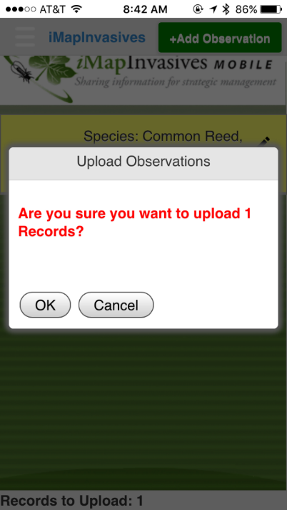
Uploading records
Notes:
You can edit the record with the pencil icon, or check the box if it’s ready

Slide 37

Uploading records
Questions about Mobile App?
Type into the chatbox!
Record is on your device, NOT in the online database
Record has left phone,
Is in online database
Notes:
Emphasis
Andrew’s last slide

Slide 38
Mobile App
1. Set Preferences
“Retrieve iMap Lists”
Custom Species List
Set Default Project
2. Record an observation of “Fake Species”
3. Upload observations

Slide 39
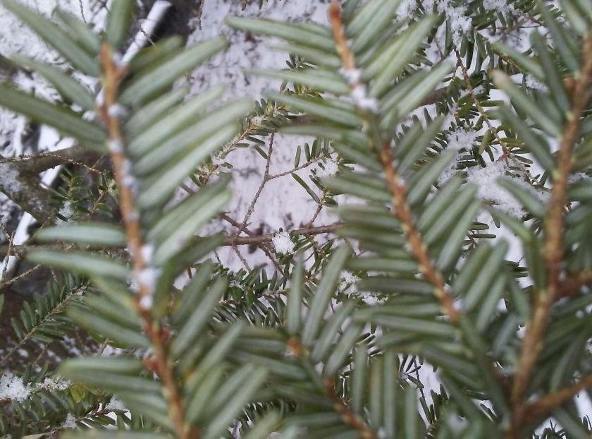
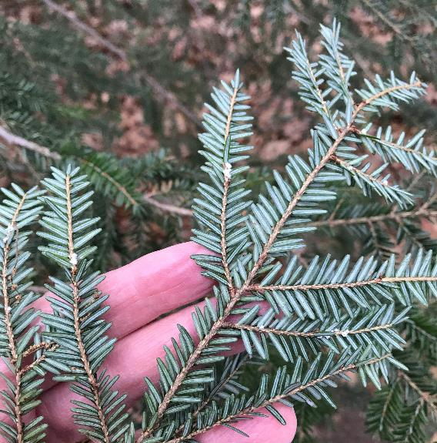
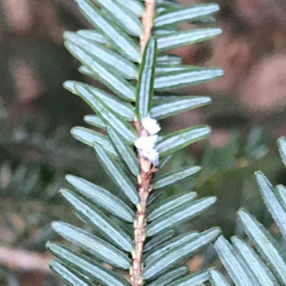

Good Photos are Essential!
Need to focused and close-up enough
Hand or sheet of paper behind plant provides scale and helps with focus
Notes:
Fuzzy photos – hard to tell if its HWA for sure
Clear photo – easier to tell its HWA

Slide 40
Mobile App vs. Online
Mobile App
Online Web Application
Questions on Account set up online?
Type into the chatbox!
Collecting Simple Data: Mobile app
Download to your mobile phone or tablet,
Presence & Not-Detected
no connectivity needed to collect data
The Whole Database: On the web
Browser-based interface for your desktop or mobile phone, with connectivity
Presence & Not-Detected & Treatment
Queries/Reports/email alerts
Google Chrome or Mozilla Firefox
Notes:
Mitch

Slide 41




Using iMapInvasives
Use Filter tool to filter on species or observer
Layers On/Off
Export/Report Tool Species list by geography
Distribution Layers
Map filtered on Fake Species before training
Notes:
Brief overview of stuff you can do with data on iMap – not required!!!!

Slide 42



Help Resources
NYimapinvasives.org
imapinvasives.org/help
Recordings of past webinars
Online help docs and tutorials
10 common terrestrial invasives
Educator resources
NY iMap helpdesk
imapinvasives@dec.ny.gov
Notes:
Make URLS bigger

Slide 43

Thank you! Questions?
Enter questions into the chat box or unmute your microphones
We encourage you to go out and map invasive species!
@nyimapinvasives
Email: imapinvasives@dec.ny.gov
Notes:
Add something about Tech support/ custom support
Anyone should be abe to submit their fake species – we

Slide 44
Advanced Mobile Tools
Name | Type | Purpose | Intended Audience | Data Outputs | Ready for Use?
iMapInvasives Mobile “Classic” Mobile App Current version: 3.0.1 | Mobile app Free from App Stores | Companion app to iMap3. Create single Presence and Not Detected point records. Works without internet connectivity after initial setup. | Trained community (citizen) scientists PRISM Staff Others | Data records created in the app are directly uploaded to iMap3 | ✔ Updates/Enhancements coming this fall/winter
iMap Mobile Advanced iMMA | Esri Collector ArcGIS Online account required | Provides the ability for users to create Presence (Points, Lines, and Polygons), Not Detected, and Treatment Polygons in the field, without internet connectivity. Provides advanced functionality not available in Classic Mobile app. | NYS Parks staff PRISM staff/crews USFWS Others, if interested | Data created in the app is uploaded to ArcGIS Online. Data records are then automatically cross-walked into iMap3 using a tool developed by NYNHP | ✔️
SAS Pro Simple Aquatic Survey Pro | Esri Survey123* | Provides the ability to document basic Searched Area fields for aquatic invasive species surveys. Includes Rake Toss fields | SLELO PRISM Staff | ArcGIS Online Small Dashboard Web Map iMap3 Crosswalk | ✔️
Forest Pest Data Collection Tool | Esri Survey123* | Advanced forest pest Survey and Treatment fields included. Also includes some fields not available in iMap3 pertinent to Forest Pests/Health. | NYS Parks Forest Health NYSHI PRISM staff Others, as desired | ArcGIS Online iMap3 Crosswalk | ✔** ** Functional Draft available – actively working to update based on input from workgroup
*Our Survey123 apps currently require an Organizational ArcGIS Online account. Depending on interest, a public link may be available in the future.

Slide 45

Certified Trainer’s Network
Train-the-trainer program that connects trainers with those who need training
Established 2017 – Brittney Rogers
>100 trainings, >1000 people all across the state
Why become a Certified Trainer?
  Contribute to ongoing and key data collection
  Engage volunteers and public
  Experience for resume
  Collaborative Network of trainers
  Resources at
  www.nyimapinvasives.org/certifiedtrainersnetwork
Notes:
Connecting people with trainers

